Slide 1
HEAT SHIELD DEPLOYMENT SYSTEM
MVJ COLLEGE OF ENGINEERING
DEPARTMENT OF AEROSPACE ENGINEERING
SIXTH SEMESTER UG PROGRAMME
MINI PROJECT
DATE: 13/08/2022 Saturday
TEAM MEMBERS
ADITYA S | 1MJ19AS003
KIRAN KB | 1MJ19AS020
VAIBHAV PAWAR BHUPENDRA | 1MJ19AS029
SATHVIK SWAMY | 1MJ19AS039
Project Guide:
Prof. Narendra Singh Maurya

Slide 2
ABSTRACT
Telescopes and Satellites that are sent to space have many sensitive instruments like photon receptors, camera lens, near-infrared spectrograph (NIRSpec) etc. These instruments require a specific temperature to function and hence the use of a heat shield becomes a necessity. Satellites require heat shields larger than can be accommodated either within the launch vehicle fairing, or within acceptable payload volumes, so deployable shields are the only possible option. A recent example of a deployable heat shield was seen in the James Webb space telescope which was launched in December 2021. A major requirement for designing a heat shield deployment system is that the folded structure should deploy in a smooth manner and that the process of deployment should be a simple one. Our design of the heat shield deployment system achieves the goal of having less points of failure and a simple opening and closing mechanism.
We have designed a folding square frame which uses a lead screw placed at its diagonal for opening and closing operations. A combination of bevel gears is used such that the adjacent arms of the square frame can unfold at right angles. The parts of the square frame are designed in Solidworks software and 3D printer is used for the fabrication of these parts. After the fabrication of all the parts, the frame is assembled and is fixed on top of a lead screw. A motor is fixed to the lead screw using a shaft coupler. Lead screw converts the rotational motion of the motor into linear motion.
The square frame design for the heat shield deployment system is an efficient design as the deployed structure covers approximately twenty-three times more area than the folded structure. The energy consumption is less as only one motor is used in the entire deployment process. In case of detection of any prospective points of failure, easy corrective measures can also be taken because of the simple design.

Slide 3
INTRODUCTION
Heat shields are structures that provide protection to a component or a person. Heat shields are applicable in many fields like satellites, re-entry vehicles, car engines, telescopes, etc. Our project will focus on the heat shields used in space. The sun- shield separates the space observatory into a warm, sun facing side and a cold side where most of the instruments and devices reside. This way the sun-shield protects the telescope from external sources of light and heat. The main problem that arises when sending such a giant structure to space in a rocket is to design the structure in such a way that it can be accommodated inside the limited space of a rocket payload. This project deals with this issue by developing a new folding mechanism in which the heat shield can fold and properly placed inside the rocket and after the satellite is in orbit the heat shield is able to deploy itself and protect the components which are placed behind it.

Slide 4
Literature Survey Literature Review
Parameter | Author | Author
Linear motion | -Robert Lipsett 2013 Robert Lipsett discusses why lead screws are the best fit for many linear motion applications and how to rightly apply them. | -Supriya Kulkarni -2015 Supriya Kulkarni discusses the demand for faster and more accurate feed drive systems.
Thermal protection | -Obinna Uyanna -2020 Different types of TPS, including passive, semi-passive and active systems, have been developed and utilized in the last few decades. This paper provides a comprehensive survey on the technology development of different classes of TPS from mid twentieth century to the present time. | -Hamidreza Najafi -2020 In this paper the various TPS technologies are presented And mass efficient TPS, simulation tools and measurement systems are discussed

Slide 5
Parameter | Author
Deployment | -Souradeep Hazra -2021 Heat shields larger than can be accommodated either within the launch vehicle fairing, or within acceptable payload volumes, so deployable shields are required.
Material properties | -Michael J. Dipirro -2008 Double-aluminized Kapton (DAK) is commonly used in multi-layer insulation blankets. A set of these shields will reflect away thermal radiation from the sun, the earth, and the instrument's warm side and allow the instrument's cold side to radiate its own heat to deep space.

Slide 6
Aluminum 6061
Properties | Values
Youngs modulus | 68Gpa
Tensile strength | 124 Mpa
Poisson's ratio | 0.33
Outer diameter | 12mm
Inner diameter | 9.44mm
Thickness | 1.28mm
Thermal conductivity | 170 W/m-K

Slide 7
PLA properties
Properties | Value
Density | 1.25 g/cm^3
Youngs modulus | 4.107GPa
Poisson’s ratio | 0.3
Tensile yield strength | 5.9MPa
Tensile ultimate strength | 64MPa

Slide 8
Physical Properties of Kapton
Physical Property | Typical Value at 200c
Ultimate Tensile Strength, MPa (psi) | 139 (20,000)
Yield Point at 3%, MPa (psi) | 41 (6000)
Stress to Produce 5% Elongation, MPa (psi) | 61 (9000)
Ultimate Elongation, % | 83
Tensile Modulus, GPa (psi) | 2.0 (290,000)
Density, g/cc or g/mL | 1.42

Slide 9
Gear calculations
Pitch Diameter: D= N/P
Diametral Pitch: P= N/D=12/36=0.333mm
Number of Teeth: N=12
Whole Depth: H_{t}= 2.188/P+0.002 =6.57mm
Addendum: a= 1/P=1/0.333 =3.003mm
Dedendum: b= H_{t}-a =6.57-3.003 =3.57mm

Slide 10
Gear details
Parameters | Values
Module | 3
Number of teeth | 12
Pitch diameter | 36mm
Pressure angle | 20 degree
Addendum | 3.003
Dedendum | 3.57

Slide 11
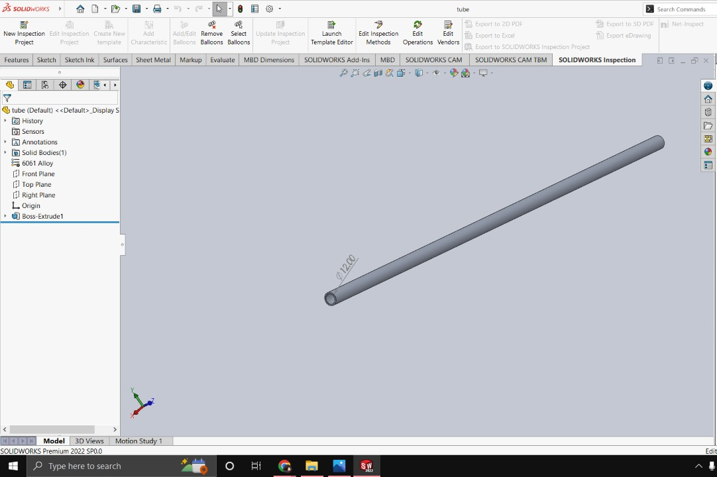
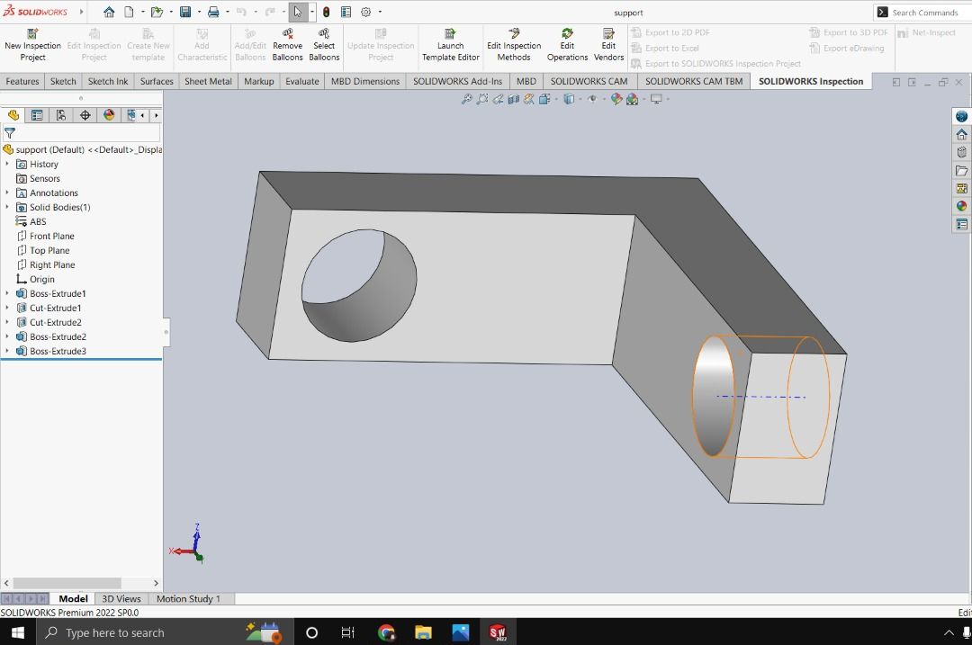
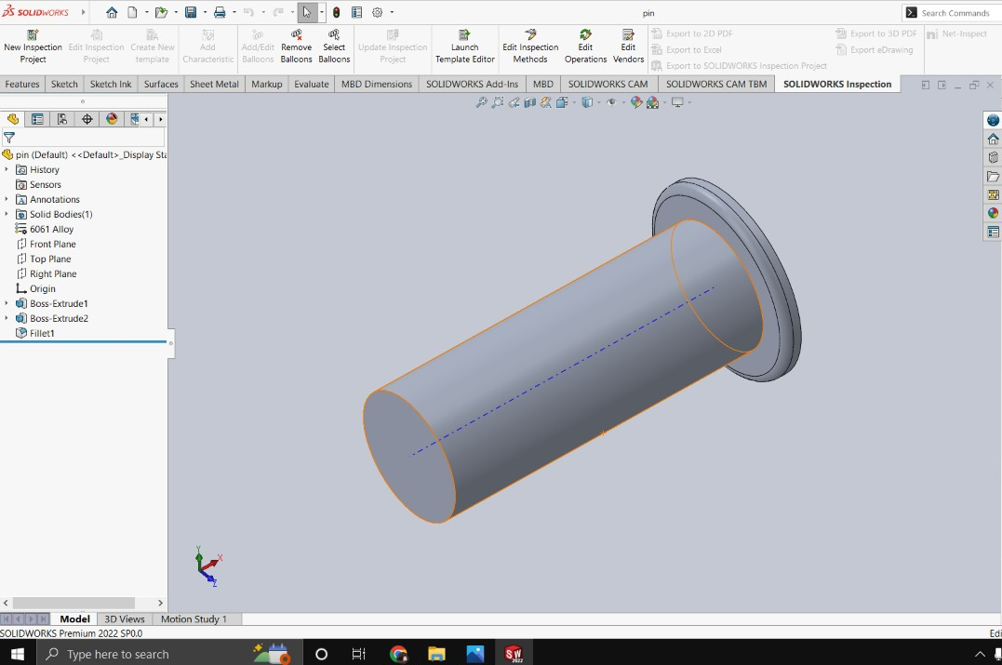
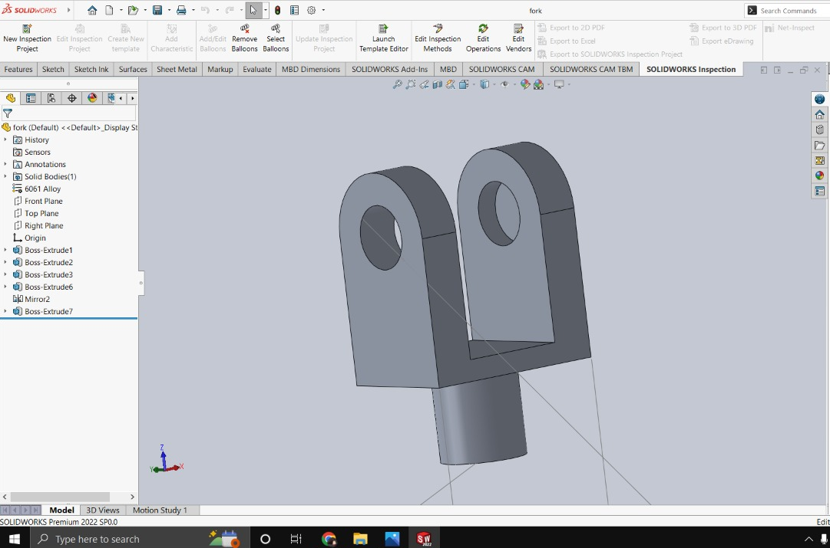
Design & Modelling
Tube
Support
Pin
Fork

Slide 12
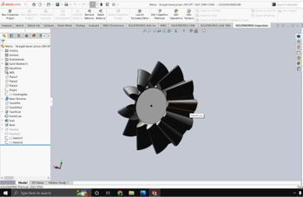
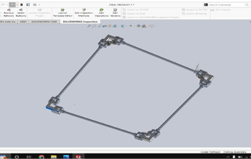
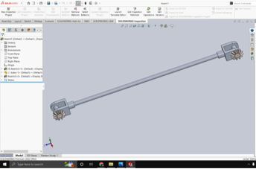
Bevel gear
Frame assembly
One-side assembly

Slide 13
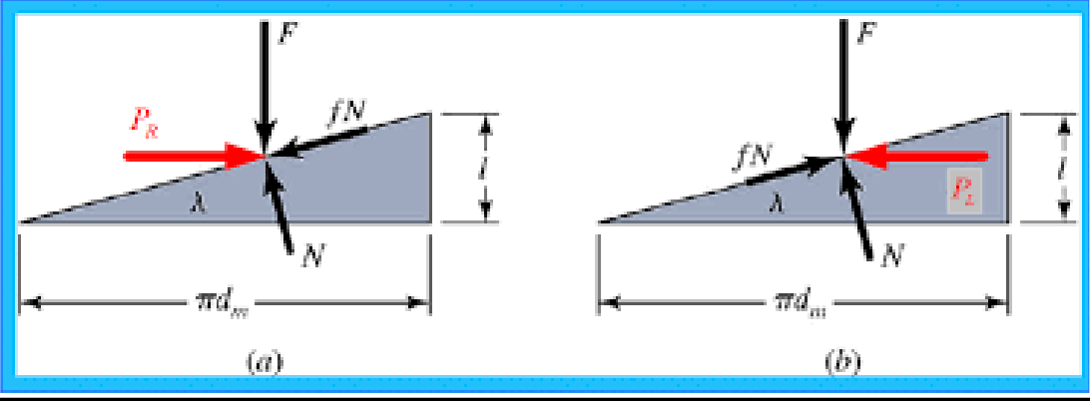
Calculations

Slide 14
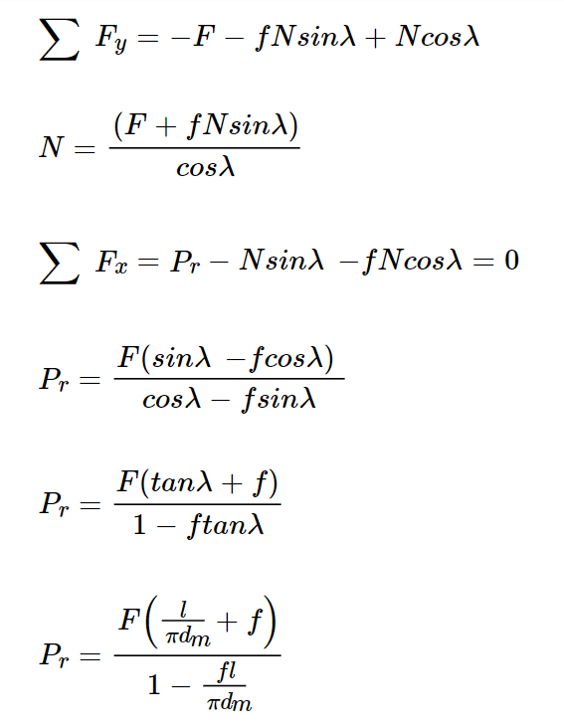
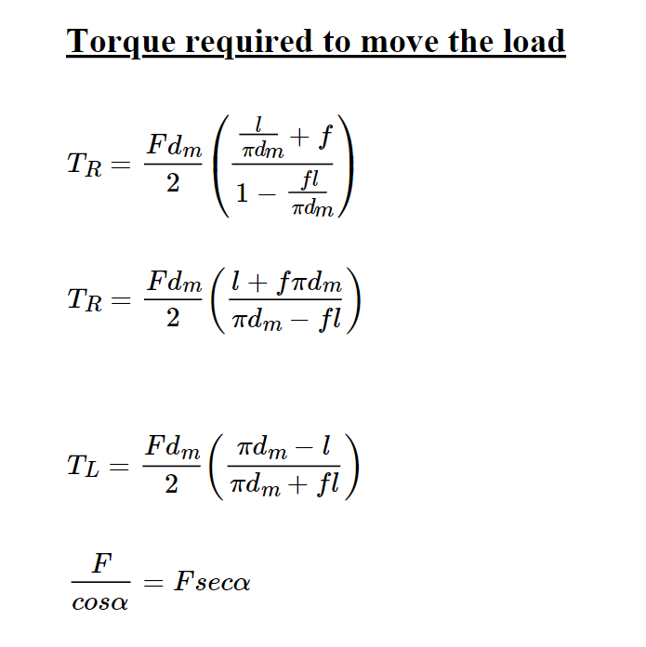

Slide 15
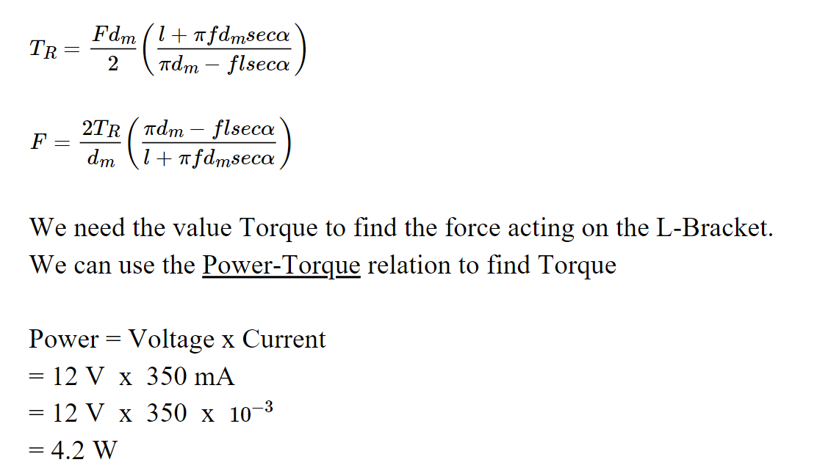

Slide 16
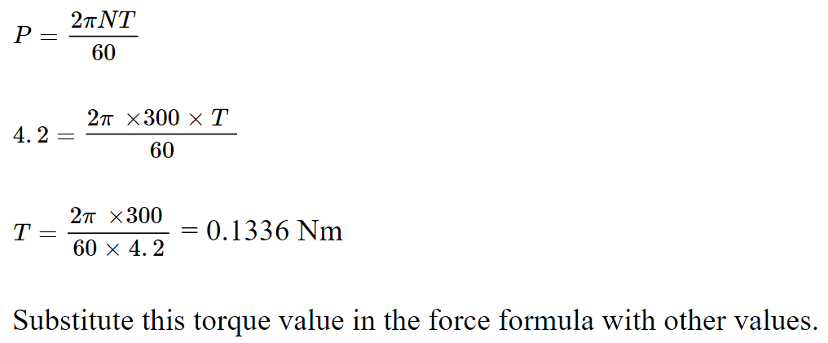

Slide 17
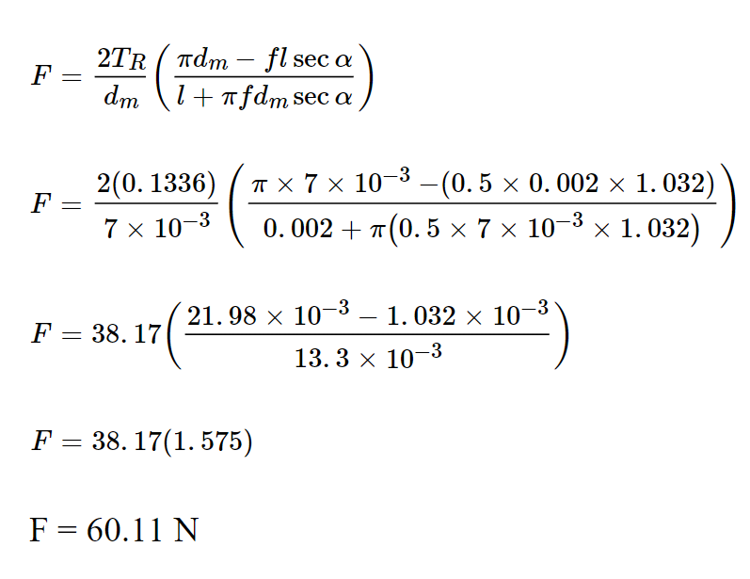

Slide 18
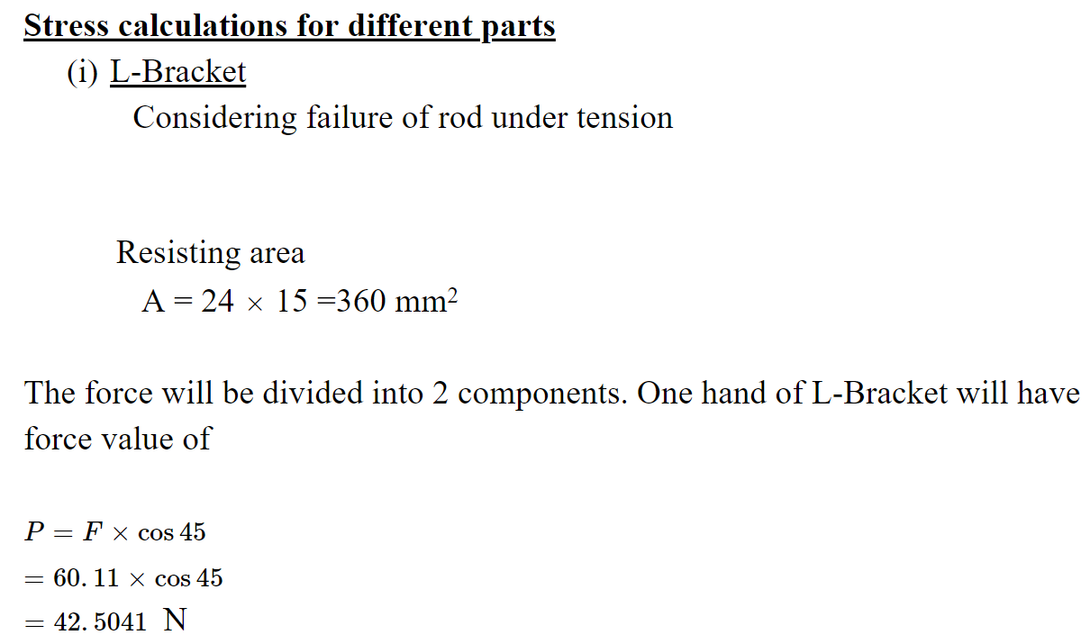
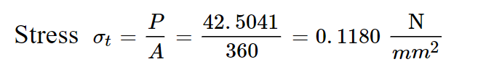

Slide 19
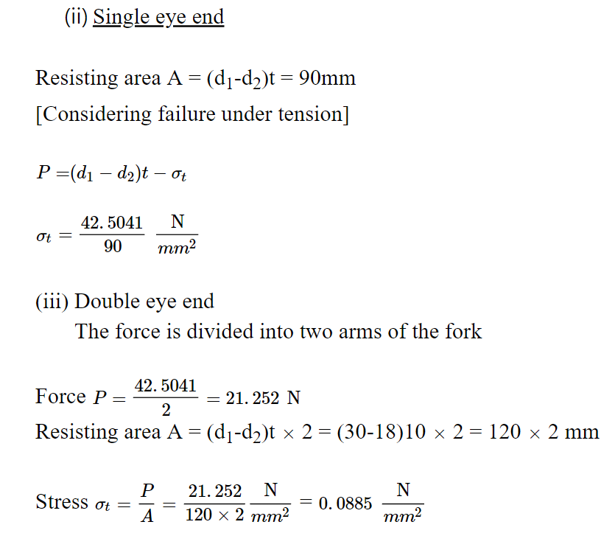

Slide 20
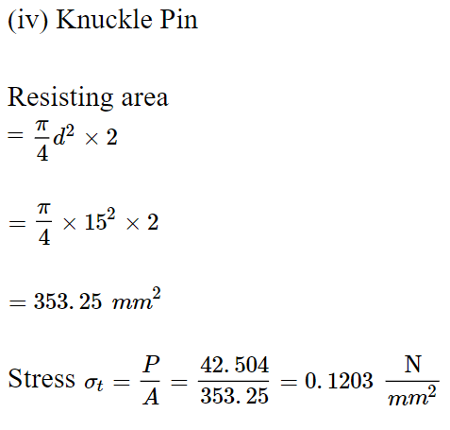

Slide 21
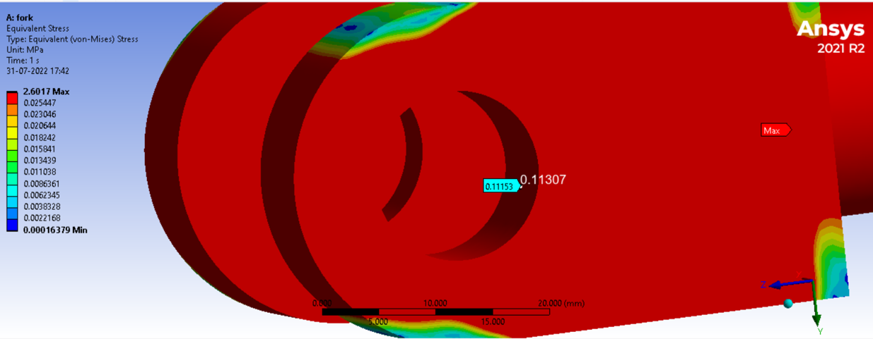
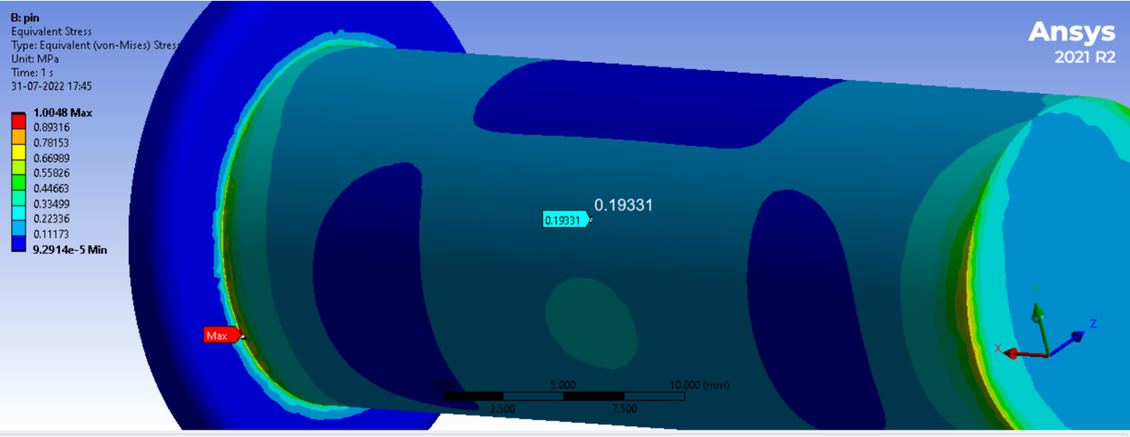
Stress Analysis
Pin
Fork

Slide 22
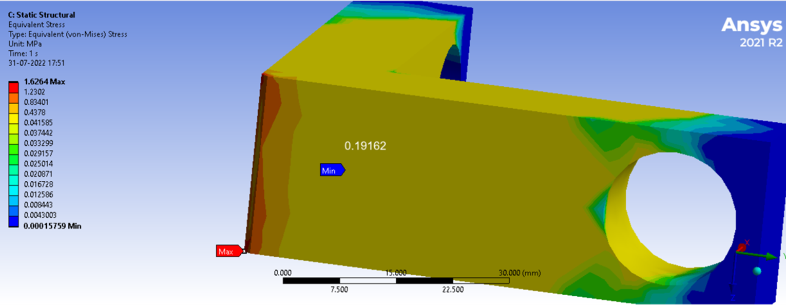
Support​

Slide 23
Mesh details
 | Fork | Pin | Support
Aspect ratio | 1.8043 | 2.12 | 2.301
Skewness | 0.21 | 0.35 | 0.44
Type of mesh | Tetrahedron | Tetrahedron | Tetrahedron

Slide 24
Calculated results
Stress | Theoretical results (N/mm^2) | Ansys results (N/mm^2)
L-bracket | 0.1180 | 0.19162
Single eye end | 0.4722 | 0.19101
Double eye end | 0.0885 | 0.11307
Pin | 0.1203 | 0.19331

Slide 25
MVJ College of Engineering
Near ITPB, Whitefield
Bangalore-560 067
M: principalengg@mvjce.edu.in
P: +91 80 4299 1040
Thank You

